Slide 1
Apple
Alexandre Dissi

Slide 2
Summary
History and origin of apple
Apple through the ages
Apple and programming
Apple's future vision for technology ?
Conclusion

Slide 3
Origin of Apple
Founded by 3 friend in steve Jobs' garage
Their first product was a personal computer
Steve Jobs was fired as CEO in 1985

Slide 4
What is Apple ?
American multinational company that creates and markets electronic products
Created in 1976 by Steve Jobs ,Steve Wozniak, Ronald Wayne
Current CEO : Tim Cook
first private company in history to reach $2 trillion in market capitalization
iPhone , iPad , Mac , Apple TV , Apple Watch
Based in Cupertino
Apple Park the apple headquarters in cuppertino

Slide 5
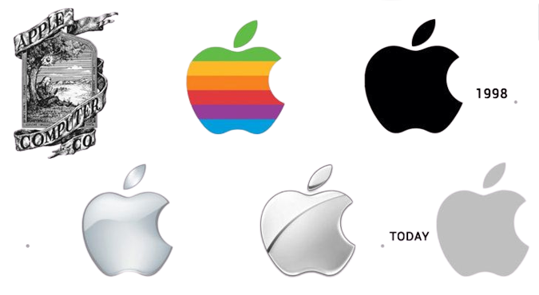
Apple thought the ages

Slide 6
Years 80’s

Slide 7
Years 90’s

Slide 8
2000 - Now
Since the beginning of the 2000s, Apple has revolutionized the technology sector with different innovations thanks to the many products that have been released.
iMac
MacBook Air

Slide 9
apple's biggest creation
The iPhone

Slide 10
Other creations that have changed the technology today

Slide 11

Apple and programming ?
App store was launched in 2008 and developers needed to create applications to use on the iPhone
At the beginning the language used was Objective C which is not a proprietary language
In 2014 apple decided to create its own language Swift and different framework to help developers
Today we are in version 5.7.1 of Swift
Swift create applications for every apple device which makes it a cross platform language
Xcode is the software to create applications in Swift

Slide 12
Apple's future vision for technology ?
What new products will they launch?
What is apple's vision of the future of technology?

Slide 13
What is apple's vision of the future of technology?
The future vision of apple is based on several points
Ecosystem that will allow to transmit all the information between products and more
Environment
New technology (foldable screen ? transparent screen , scrollable screen)
Blockchain, CryptoCurrencies ?
Virtual Reality
Build is own computer processor
Privacy

Slide 14
Titan Project
The automobile is a lucrative business
Apple wants to compete with Tesla in high-performance and technological vehicles
Electric vehicle
Autonomous vehicle ? Artificial intelligence ?
Project that should exist only from 2026

Slide 15
Apple wants to create an ecosystem to allow their probable future car to communicate with the different apple devices owned by the user
Apple's future vision of the automobile would be an electric vehicle centered on technology
example with the opening of the car with the iPhone or the watch

Slide 16
Virtual Reality
The virtual reality is in full expansion since several month, year
Apple takes its time to understand the technology and adapt it to his vision
Creation of a MetaVerse to compete with Meta for example?
Possibility of creating a game because Apple is absent from the gaming community at the moment

Slide 17
Apple Glass
Apple sees augmented reality as an innovative vision
Apple believes in augmented reality for medicine, creation but also for entertainment
Already implemented in iOS with some function of augmented reality to help the user to choose its future decoration for example

Slide 18
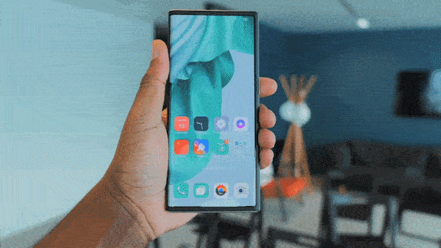
Future of the phone according to apple
Apple has shown interest in a scrolling screen rather than a foldable screen like Samsung
The main goal would be to have a normal size phone and then once enlarged to have a mini tablet to play or watch content
difference between foldable screen and scrolling screen ?
technology not yet perfected to be already on the iPhone
Not before 2026 minimum
OLED Screen

Slide 19
Future of computer science according to apple
Apple since the end of 2020 to create its own processor
Apple wants to dethrone INTEL or AMD on the processor market by creating a powerful and economical processor at the same time
Total disappearance of passwords for a new passkey technology (in agreement with Google and Samsung)
Create a more powerful search engine that respects the privacy of users unlike google

Slide 20
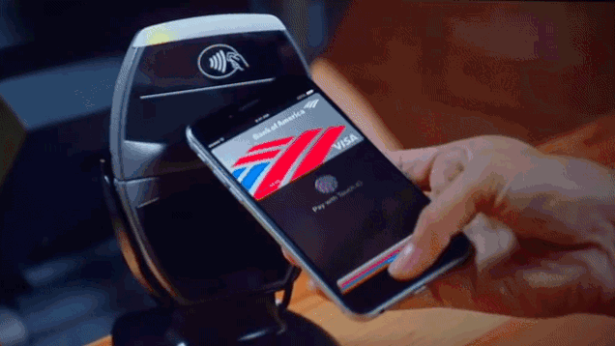
Crypto Currency ?
Apple Card created in 2019
Apple has created his banking service in connection with Goldman Sachs and masterCard that allows to get cash back
Creation of Apple Pay in the past which simplifies and ensures a security
For the future Apple would be interested in the world of cryptocurrency
We can imagine that Apple in the future could link its banking service with the cryptocurrency to pay in bitcoin

Slide 21

Conclusion

